Slide 1




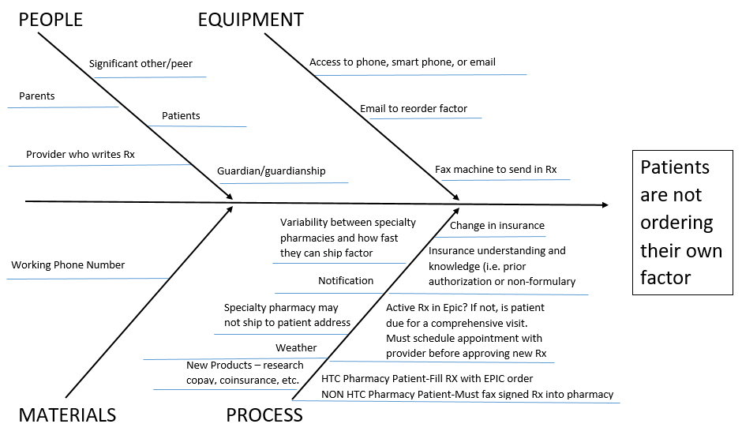
Factoring It In: Increasing The Number Of Patients Who Order Their Own Factor Between the Ages of 17-22
Alison Schomerus, Pharm D, Audra LeBlanc, LCSW, Christine Mashburn, BSN, RN, Nancy Spomer, BSN, RN, Susan Harvey, CPNP-AC, Elizabeth Gibson, PA,
Tyler Buckner, MD, Michael Wang, MD
Specific Aim
Process
Lessons Learned
We will increase the number of patients aged 17-22 that order and obtain their own factor from the current baseline to double the number of patients ordering by September 1, 2016
HTC Pharmacy reviews individual patient factor ordering over the past 12 months and presents data in weekly patient meeting.
Morning Clinic Huddle:
Identify transition patient in clinic each day
Improve summer camp planning. Unmet goal of:
  Completing green transition index cards with leadership due to time constraints and setting
  Making a poster for check-in
Establish specific time frames for periodic review and revision of data (i.e. every 2 months)
Scheduled protected time is critical so team can have working meetings
QI team practiced meeting skills and learned the importance of large team representation in order to maintain momentum.
QI team dynamics are complimentary to each other
Adobe Connect session were not a high priority for our team due to time constraints
Recognize that the process to change is possible. This process can be applied on a small or grand scale with efficiency
Identify patients in comprehensive clinic that are between the ages of 12-22
Global Aim
Comprehensive Visit Questions:
Have you run out of factor in the past 6 months?
Do you order your own factor?
Pharmacist completes Green Transition Index Card with patient and give it to them to take home
We aim to improve the ability of a 17-22 year old to self-manage their health care at the HTC. University of Colorado/Children’s Hospital
The process begins at age 12 (+/– 2 years) and ends when the young adult is able to demonstrate good self care over a 2 year period (2 comprehensive visits)
Successful transitions for our patients include patients: ordering factor and supplies prior to running out, scheduling their own clinic appointments, self-reporting bleeds, understanding factor dosing, maintaining treatment logs, demonstrating a basic understanding of the cost of care/insurance, and practicing appropriate disclosure/self-advocacy.
It is important to work on this now because giving young people with bleeding disorders the tools to manage their chronic disorder before they emancipate into adulthood will help them navigate the already complicated world
Next Steps
Use and focus our project results in:
  Identify transition priorities with all disciplines practicing in the HTC
  Transition education posters in exam rooms
  Develop and initiate annual patient transition competency questionnaire (1/1/17)
Pharmacist collects and records weekly data from:
1.Comprehensive visits
2. Refill telephone calls to the HTC pharmacy only
Fish Bone
Last Name | First Name | DOB | Age | Gender | Primary Diagnosis | Severity | Pharmacy | Transition Pts ordering their own factor prior to 4/1/16 | Pt Ed complete | green card given | Pt ordered after 4/1/16 | # of times Patient ordered since 4/1/16 | total orders since 4/1/16 | Prophy
Mouse | Mickey | 5/15/2003 | 10 | Male | FVIII | Severe | HTC | no | yes | yes | no | 0 | 6 | yes
Ventura | Ace | 7/14/1997 | 16 | Male | FIX | Severe | HTC | yes | yes | yes | yes | 4 | 5 | yes
Introduce the Green Transition Index Card to leadership boys (ages 14-18) at summer camp July 2016.
Periodic review of data by QI team members.
Review and revision of comprehensive clinic transition education process
PRELIMINARY DATA (4/1/16-9/1/16)
53 patients completed the Green Transition Index Card
Out of the 85 HTC Pharmacy patients, 23 are calling in their own refills
The number of HTC Pharmacy patients that call in their own refills has increased by 4 since 4/1/16
Data collection and transition project continues in order to analyze success of this transition project

