Slide 1

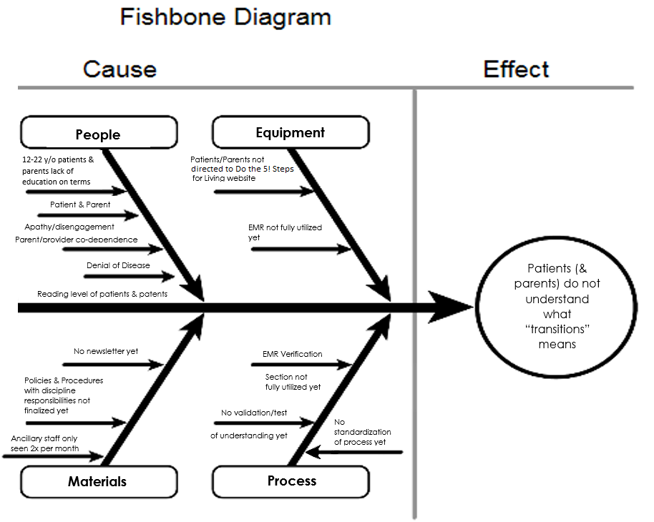
Implementation of a Transition Focused Quality Improvement Program to Increase Self-Advocacy in Patients with Bleeding Disorders.
Lisa C Palmer, DO; Andrea B Miller, RN; Jay J Charles, RN; Jamison C Buxton; Brian J Barkow, PharmD - Hemophilia Outreach Center, Green Bay, WI Your name
Global Aim Statement:
Specific Aim One
Specific Aim Three
The Hemophilia Outreach Center (HOC) aims to improve pediatric to adult transition beginning with patients 12 years old and ending with patients turning 23 years and/or patient completes and feels comfortable with all steps of transition. By working on the process, we expect to improve patient self-advocacy in managing their own health, patient health outcomes and patient satisfaction with the transition process. It is important to work on this now because many young adults still rely on parents for medication management, it is a quality measure, many young adults demonstrate non-compliance, and it will improve health outcomes.
Specific Aim: 100% of patients between ages of 12 and 22 presenting to comprehensive care clinic will be taught what transition means from February to August 2016.
Operational Definition: Ranking understanding of transition (Yes, No) in 1st PDSA to (Yes, Somewhat, No) in 2nd PDSA
Specific Aim: Evaluating success of transition by monitoring patients’ independence in self-care in 100% of patients ages 12-22 presenting to comprehensive care clinic from September 2016 to February 2017.
Operational Definition: Survey results
Plan-Do-Study-Act:
The American Society of Hematology – Hemophilia Transition Readiness Assessment Template was modified to survey patients on transition readiness and competency at the HOC (H)
Survey administered at the beginning of each annual visit, and collected once filled out at the end
Results will be used to tailor transition education to each patients’ needs
Problem Description:
Plan-Do-Study-Act:
A process on educating patients and families on the meaning of transitions was incorporated into clinic day workflow. As hematologist, nurses and pharmacist were part of transition QI team, hematologist and nurses would educate, pharmacist would assess knowledge and re-educate as needed (C)
HOC’s newsletter ran an article on meaning of transitions (E1)
At HOC educational events, transitions was explained to the community (E2 & E3)
The process of transitioning patients to adult medical care can be delayed or incomplete due to failure to address barriers to the process. These barriers include:
Many patients/parents are not aware of what the word transition means, thus are confused when staff talks to them about it
HOC does not have a method to provide evidence the patient is capable and competent to address his or her own healthcare needs during and after transition
HOC is not currently able to verify it is providing a transition process
HOC is not currently able to effectively collect and retrieve the data verifying patients are making improvement in the transition process
HTC demographics – Freestanding, Urban/Rural, Life-span HTC – 445 patients (67 patients 12-22 years old)
Data Collected: 2/2 (100%) of patients ages 12-22 completed survey
Pt age:
Mean: 15
Median: 15
Range: 11-21
Results – Key Findings
Specific Aim One:
12 patients ages 12-22 received education on term transition
5 were able to describe transition on first attempt, 3 somewhat described transition, 4 could not
7 received education again on term transition
On second attempt 6 described transition, 1 could not
Specific Aim Two:
14/15 (93%) patients ages 12-22 received transition education
Specific Aim Three:
2/2 (100%) of patients ages 12-22 completed survey
A Timeline of Activities:
Standards for transitioning bleeding disorder patients were obtained from NHF’s website, reviewed and divided by each discipline (A)
Initial meeting in Baltimore helped identify goal of first Specific Aim: to educate patients and families regarding what transition means (B)
Integrated Care Clinic process developed and refined to have pediatric hematologist and nurses explain transition meaning to patients and pharmacist to review and determine understanding – after process was in place, response data was collected (C)
Cycle times during Integrated Care Clinic began to be tracked and collected (D)
HOC educational forums, newsletter and community events were utilized to educate patients and parents about transition (E1, E2, E3)
Standards for transitioning bleeding disorder patients were formalized into Policies and Procedures after each discipline reviewed relevant transition guidelines (F)
In each patient’s Comprehensive Treatment Plan Summary a section was added for each discipline to document he or she covered applicable transition standards with the patient (G)
American Society of Hematology - Hemophilia Transition Readiness Assessment Survey Template was modified to assess patient’s capacity to manage his or her own healthcare needs (H)
Specific Aim Two
Specific Aim: Creating and utilizing formal transition guidelines to improve the process of transition for 100% patients age 12-22 presenting to comprehensive care clinic from June to September 2016.
Operational Definition: Transition education given – Yes / No
Summary/Lessons Learned
In the care HOC gave patients, transition education was already occurring, but there was no formalized process and data was not being tracked regarding transition. Initiating a QI program at HOC identified areas for improvement, standardized the process of transition education and created a process to accrue collect data to verify the impact of transition education to enhance patient care.
Obstacles in initiating a QI program → Lessons Learned:
Hesitancy toward the new and unknown due to HOC’s limited experience with QI → QI can be effectively implemented without previous experience
Concern HOC is too small for effective QI → QI was able to be implemented and provided a clear benefit to the center
Concern need for QI implies deficiencies in patient care → QI helped identify the high caliber of existing patient care and demonstrated areas in which patient care could be enhanced
Time management of frequent meetings and QI program requirements are challenging → Utilizing the entire team, being flexible and having commitment keeps the process moving
Plan-Do-Study-Act:
Each member of multidisciplinary team reviewed NHF’s MASAC bleeding disorder transition guidelines (#147) and adapted them for HOC (A)
Standards were divided among clinical disciplines at the HOC and each discipline reviewed the relevant standards (F)
Formal Policies and Procedures were developed to assign standards each clinical discipline (F)
At Integrated Care visits, each discipline covers appropriate transition standards with patient and documents on each patient’s Comprehensive Treatment Plan Summary the standards were covered (G)
Data from Third Specific Aim will be used to adjust this process (H)
Data Collected: 14 /15 (93%) patients ages 12-22 received transition education.
Timeline of Activities
A
E1
E2
F
G
E3
January February
March
April
May
June
July
August
September
October
Funding Source: HRSA Grant Number UC8C24079
B
C
D
H

