Slide 1


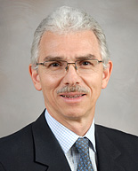
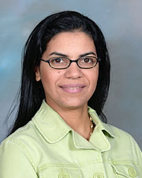
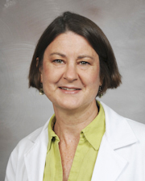
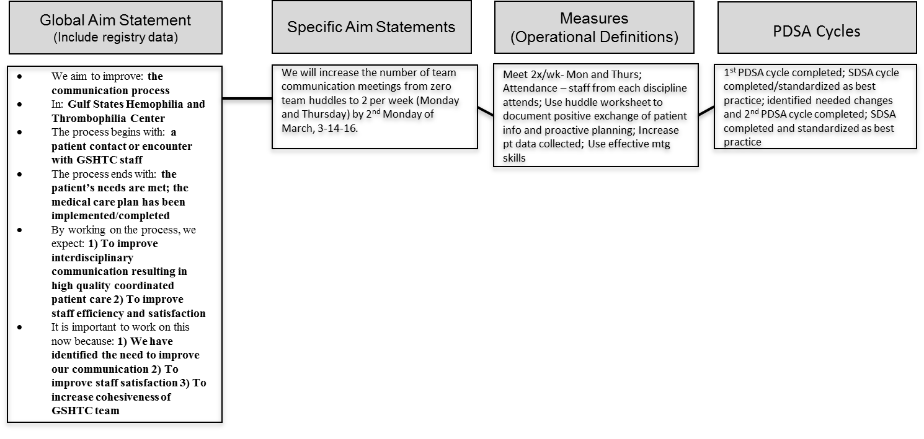

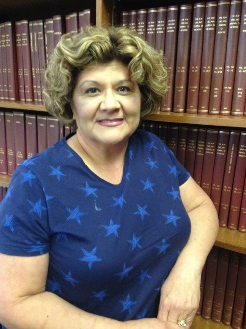
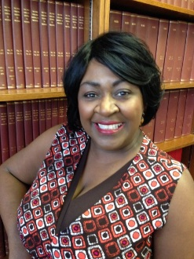
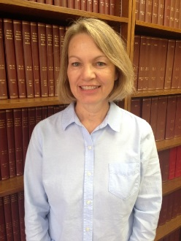
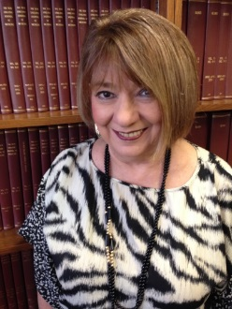
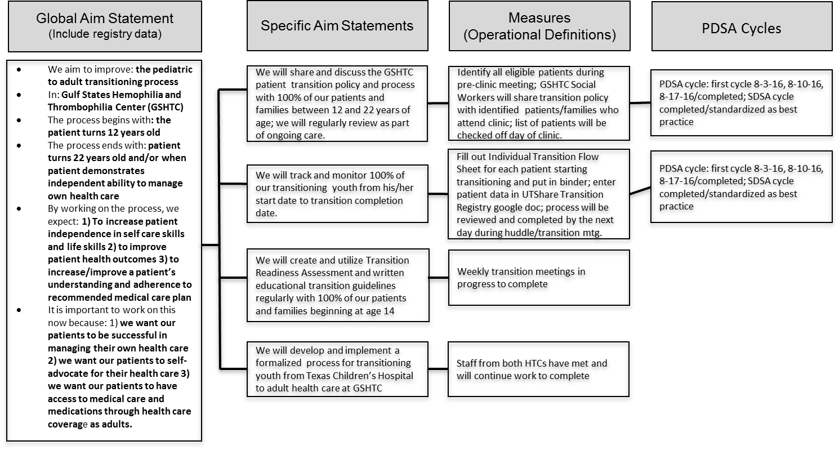
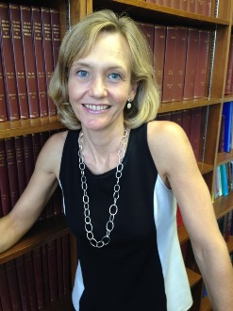
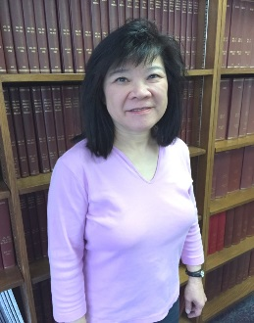
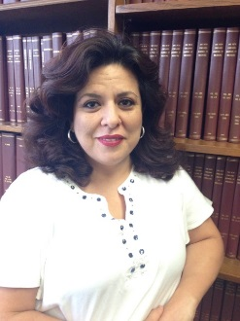
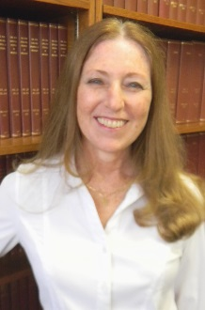
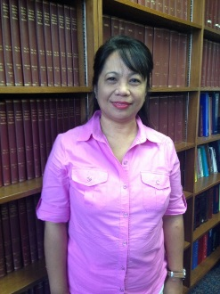


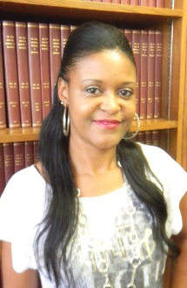

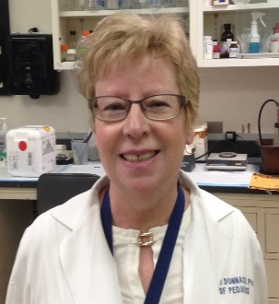
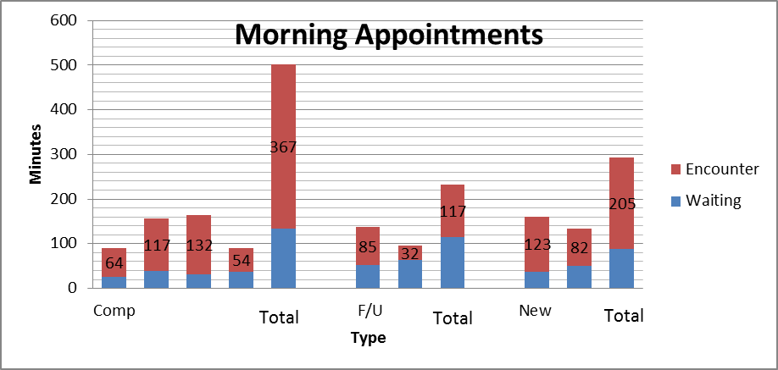
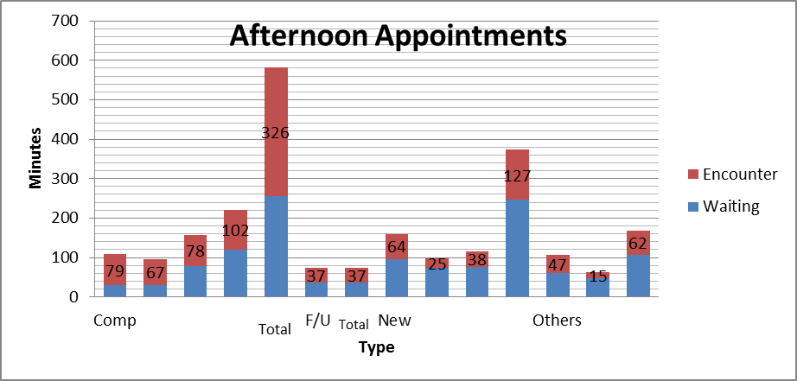
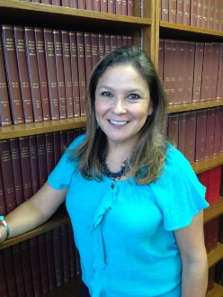
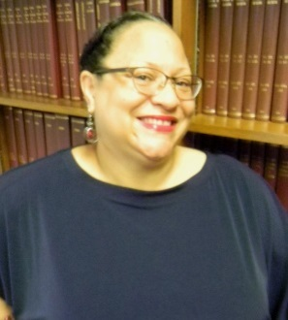
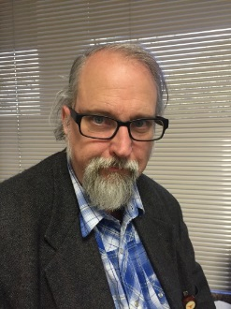
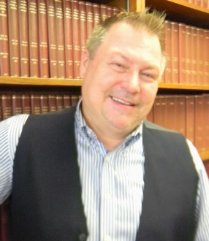
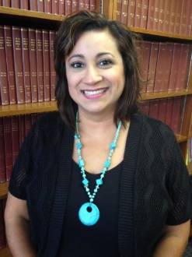
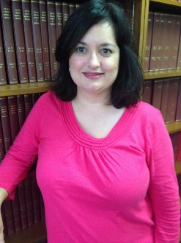
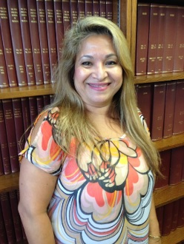
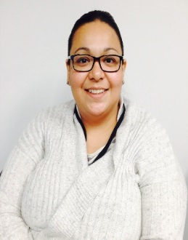
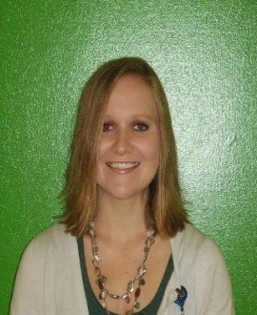
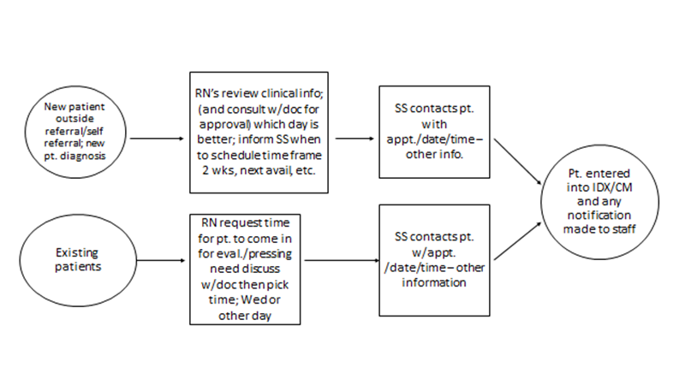
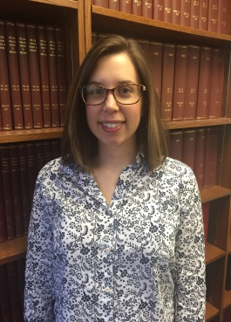
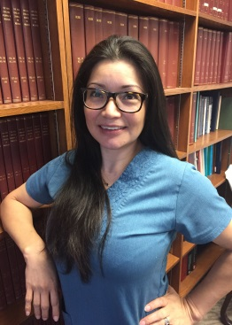
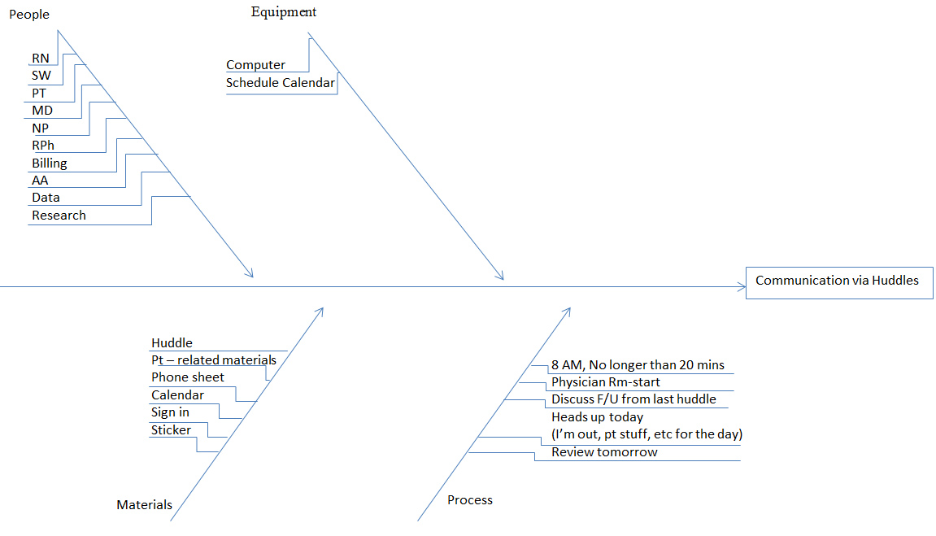
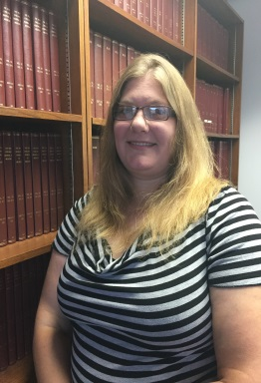
Building Transitioning Through Communication: A Unique Experience at
Gulf States Hemophilia and Thrombophilia Center
Authors/Lead Team: Oldfield D., Cantini M., Gonzaga C., Nguyen T., Trujillo M., Escobar, M.
Background:
The Gulf States Hemophilia and Thrombophilia Center (GSHTC) is located in Houston, Texas, and serves approximately 800 pediatric and adult persons with bleeding and clotting disorders. Our Center was chosen as one of 10 sites across the country to participate in the American Thrombosis and Hemostasis Network (ATHN) Improvement Collaborative as part of the National Hemophilia Program Coordinating Center (NHPCC) cooperative program with the Dartmouth Institute. This Quality Improvement program was initiated in December 2015 and is ongoing.
The aim of this quality improvement program was to leverage ATHN Clinical Manager technology and ATHN dataset to perform activities that result in superior care and outcomes for patients and providers. We were also tasked to develop a transitioning program from pediatric to adult care.
Our improvement team met weekly by teleconference with our Dartmouth Institute Senior Team Coach. We chose to open the meeting to all staff members and promoted inclusion of at least one person from each discipline. Customized learning plans were provided and served as a guide for assessing processes that would contribute to Quality Improvement Aims. Additional leadership calls were held and monthly web-based sessions provided other opportunities for learning.
From these materials and meetings, we identified areas for improvement within our center and worked together to assess and improve our clinical microsystem. Once issues were addressed and improvement changes were standardized as best practices, we tackled the core process of HEALTHY PEOPLE 2020, transitioning patients from pediatric to adult health care.
Problem Description: Communication
The improvement team identified a need for improved communication from the results of our staff satisfaction survey and our communication patterns. Aside from a weekly pre-clinic meeting, we had no clinic huddles, infrequent staff meetings and inconsistent exchange of patient information amongst the clinical staff. We realized that we needed to improve our patient focused interdisciplinary communication before we could begin the process of transitioning our patients.
Huddle Fishbone:
This process broke down the essential resources of people, equipment, materials and processes and identified the starting point for the Global Aim and Specific Aim.
Global and Specific Aims for Huddle:
Description of the steps for improvement and the Plan, Do, Study and Act (PDSA) Cycle with findings of this specific aim.
Transitioning Process Implementation:
The GSHTC improvement team identified that we did not have a formal transitioning program in our center. While our staff has experience in using transitioning guidelines and provides ongoing transitioning education, we do not have a standardized or cohesive method of transitioning our pediatric patients to adult healthcare. Experience from meeting as a team approximately 100 times in huddles and QI meetings gave us the ability and skills to initiate transitioning.
Global and Specific Aims for Transitioning:
Description of the steps for improvement and the PDSA Cycle with findings.
Findings:
Starting in March 2016, we have met twice a week 100% of the time. A clinical staff member from each discipline attended the huddle consistently. We used huddle worksheets to document positive exchange of patient information and to ensure patient follow up. The data manager has been able to increase patient data collection for ATHN Clinical Manager database. Team members have utilized effective QI communication skills which have resulted in improved patient care.
Methods of 5Ps (purpose, patients, professionals, processes and patterns):
We assessed the 5Ps to improve communication and patient care to move towards
transitioning objectives. (See examples below of data obtained.)
Patient Cycle Time Data:
Total time spent with professionals vs. total wait time from check in to check out.
Findings:
We meet on a weekly basis immediately following one of our huddles to create our transitioning program. We have written a patient transition policy that is shared and discussed with 100% of our patients and families between 12 and 22 years of age. Patients are tracked and monitored 100% using an individual transition flow sheet and electronic registry. We are in the process of completing our transition readiness assessment tool and educational modules. We have also met with the nearby pediatric HTC to develop and establish a formalized process for transitioning to our adult center. The staff from both HTCs will continue to meet to move forward with this process.
Patient Satisfaction Survey (PSS):
Improvement team created PSS that was surveyed over 2 weeks with results.
Gantt Chart / Time Line:
Summary of completed and ongoing activities
Hemophilia Clinic Appointment Scheduling Flowchart:
This depicts the improved process.
Lessons Learned from QI Program:
QI is doable and can be incorporated in an HTC regardless of size, but it will take time and effort
More efficient communication has allowed us to identify, evaluate, and improve any process
We remain a work in progress
We have become successful in planning and implementing various initiatives
Helped us as a team to provide better patient care
Continue following the clinical microsystems process
As a regional coordinating center, we have promoted QI with other HTCs at various regional meetings
Building a higher performance transitioning program is attainable
HRSA Grant #UC8C24079

