Slide 1

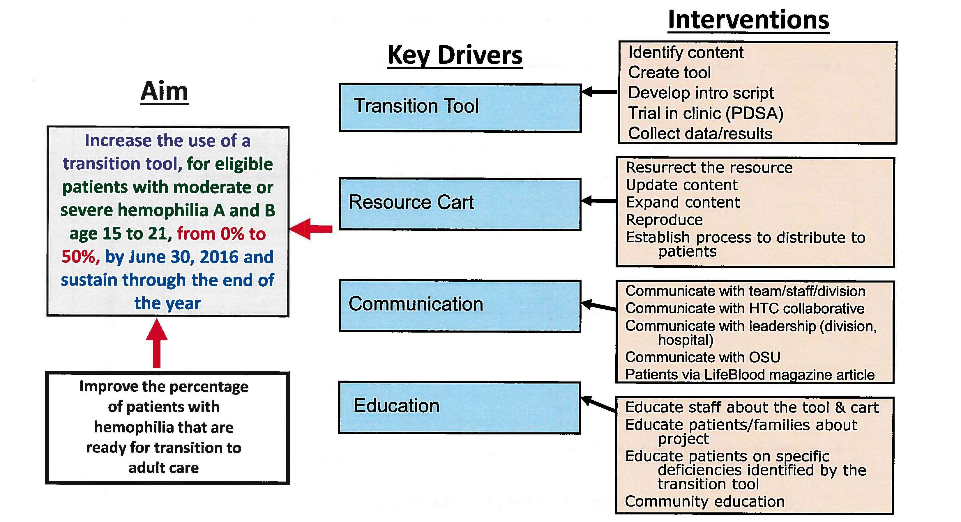

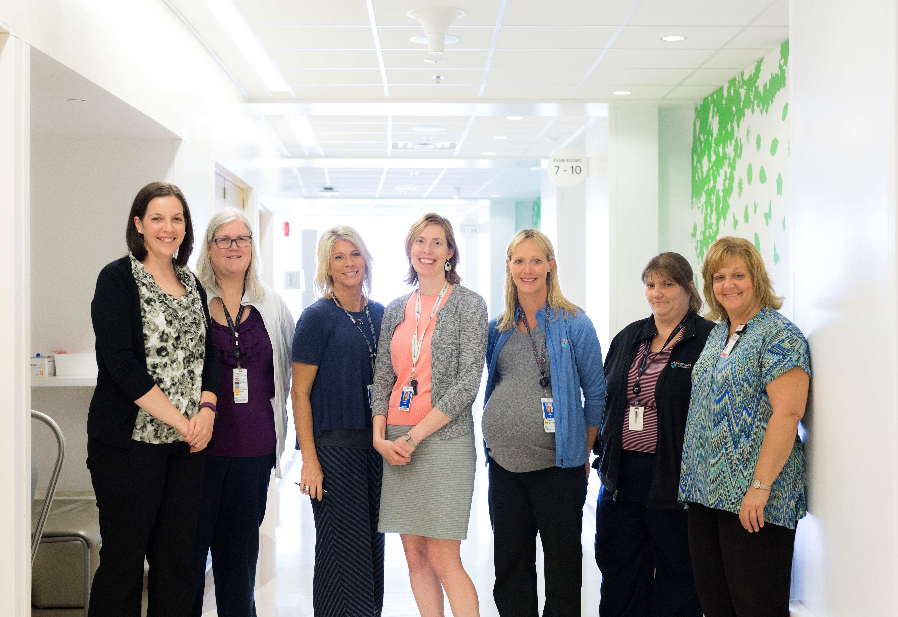
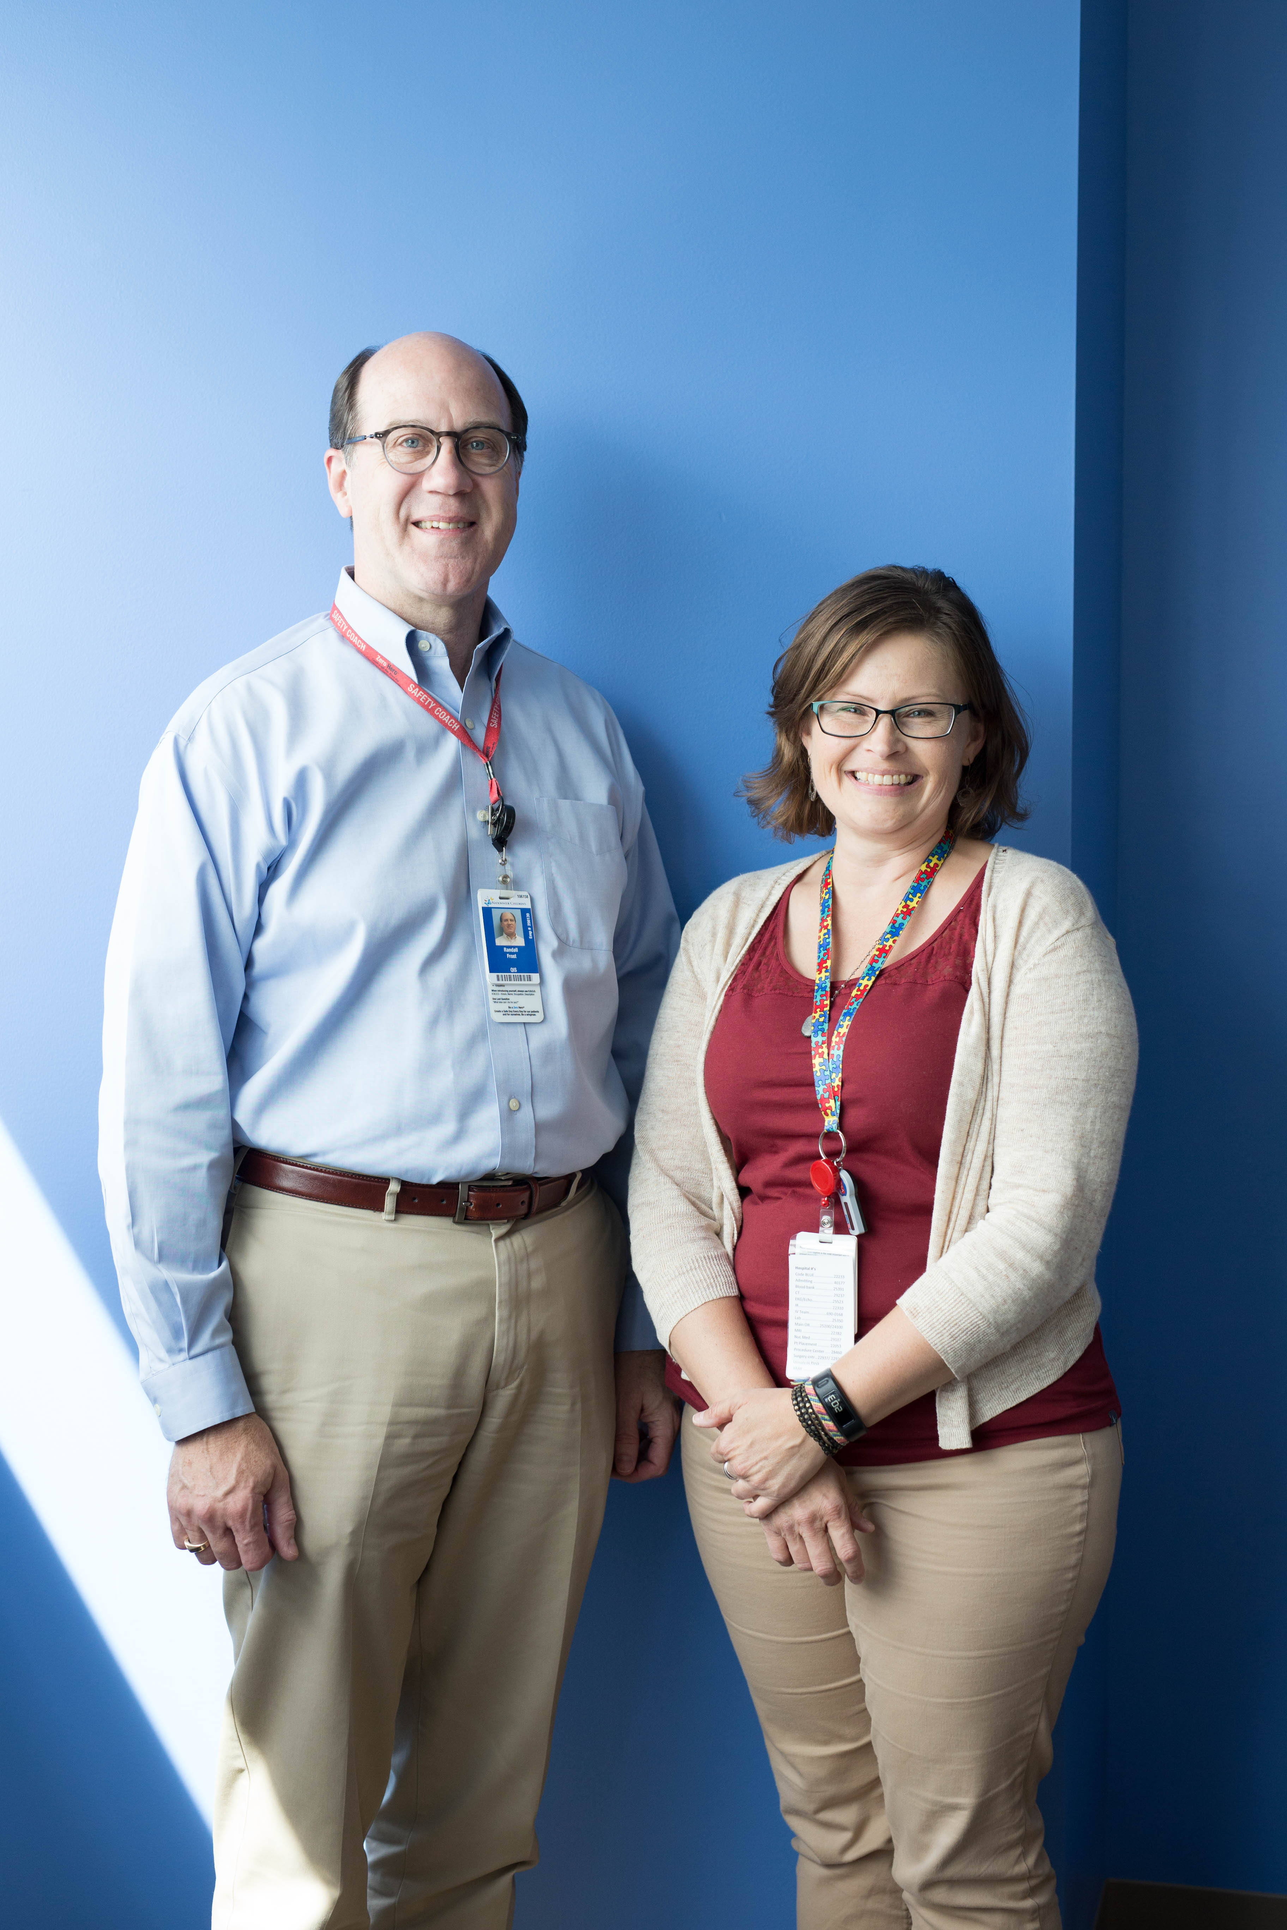
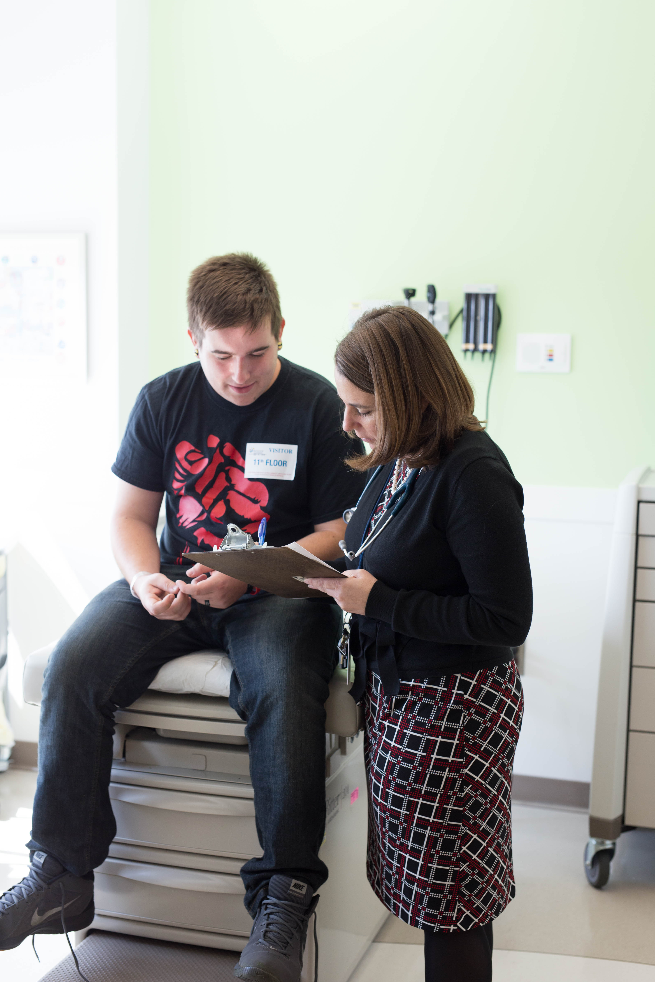
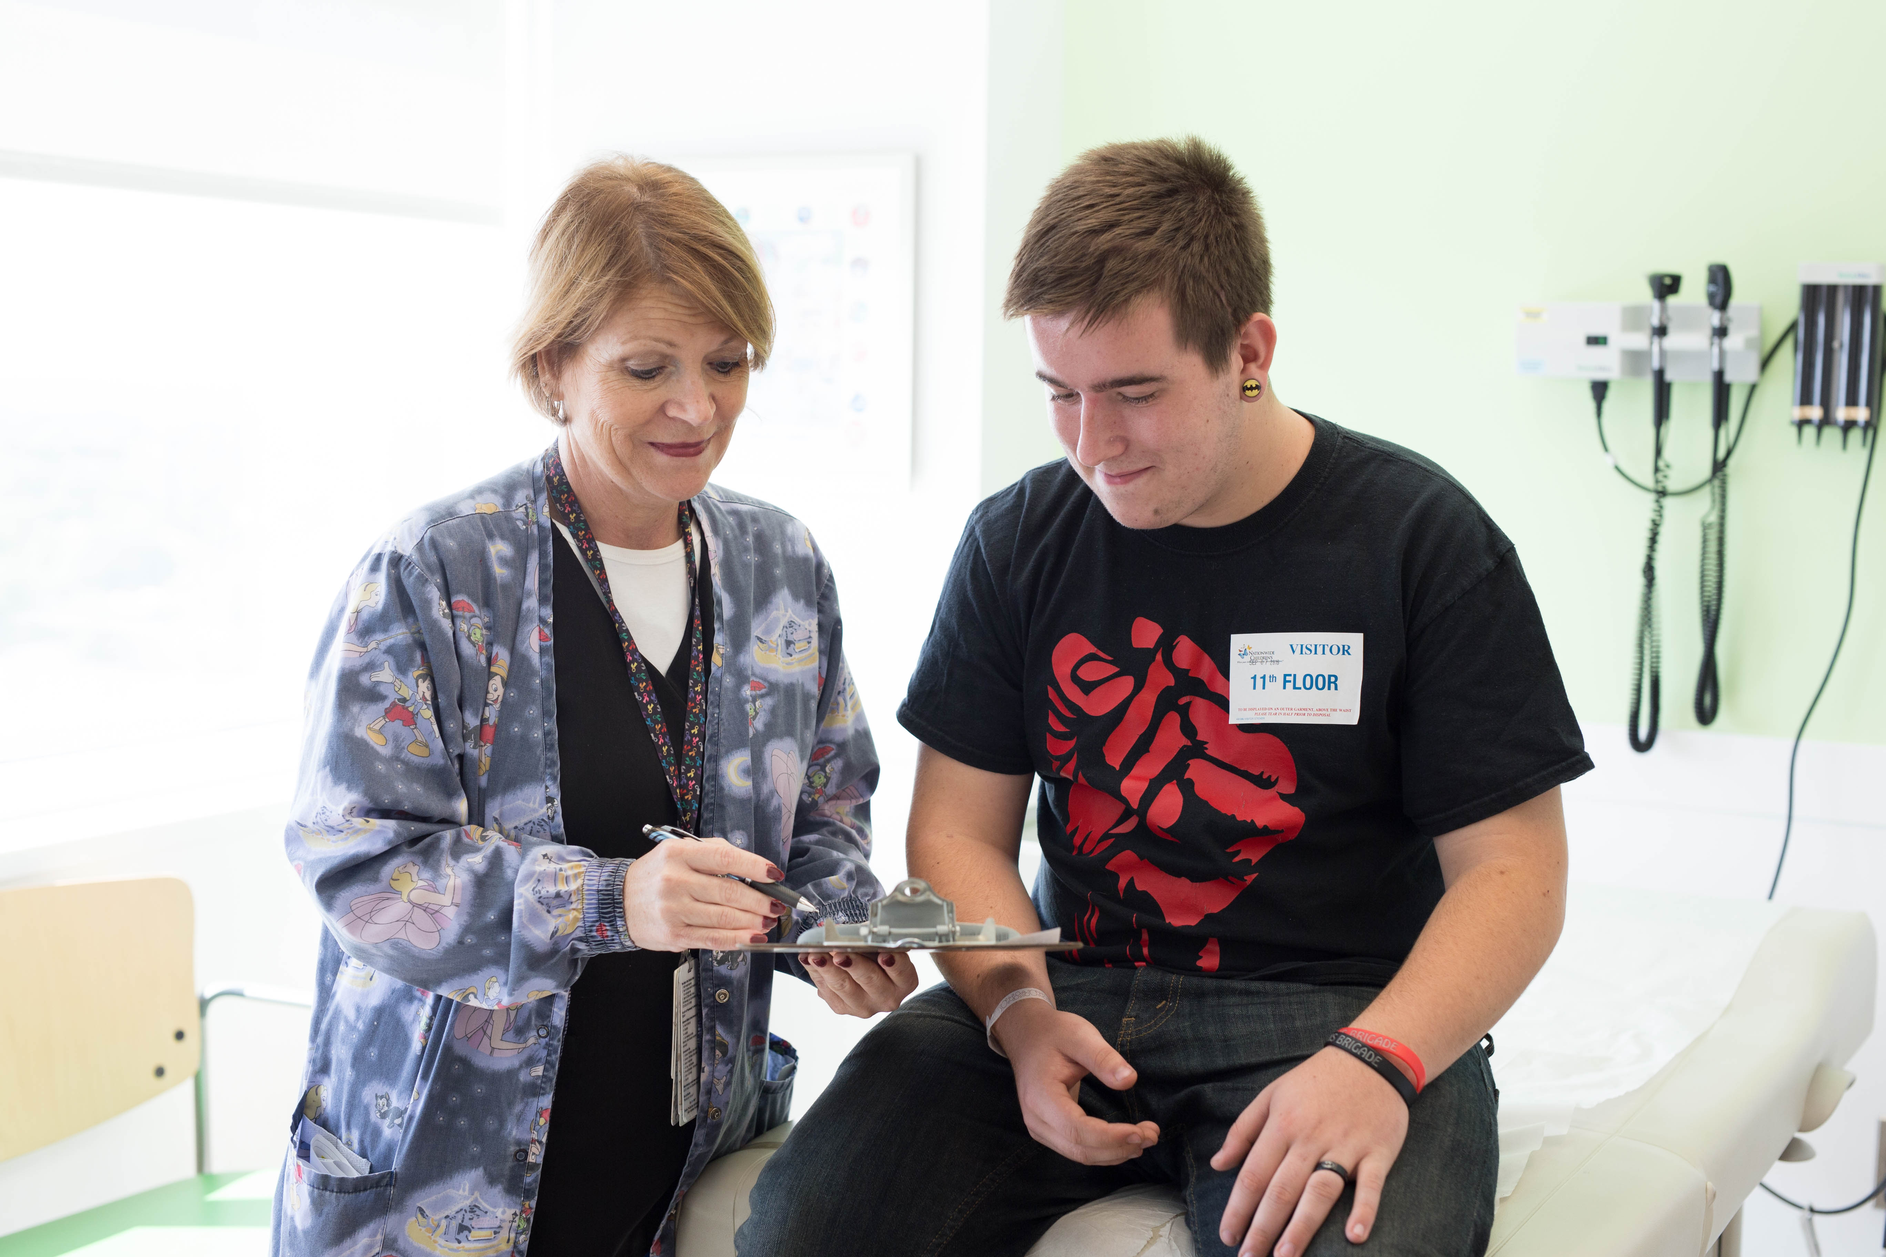
Journey to Best Outcomes in Hemophilia Transition:
Enhancing Quality on the Pathway to Independence
Casto L¹, Frost R¹, Beemiller L², Biega C¹, Brown M¹, Gonzales A¹, Hatfield A¹,
Krebs B¹, Messier R⁴, Roessler S³, Russell C^{1,2}, Varga E^{1,2}, Widener P¹, Dunn A^{1,2}
,
1. Nationwide Children’s Hospital 2.The Ohio State University 3. Northern Regional Bleeding Disorder Center 4. Dartmouth Institute
Improve the with hemoplia that are ready for transition to adult care
Background
Methods
Results
About Us: The pediatric hemophilia treatment center (HTC) is located at Nationwide Children’s Hospital (NCH) a nearly 500 bed facility located in metropolitan Columbus, Ohio. The James Cancer and Solove Research Institute on the campus of The Ohio State University Medical Center houses the adult HTC. We serve patients and families with bleeding disorders over a 44 county area, including patients from Ohio, Kentucky and West Virginia.
Our Quality Improvement Team includes: Hematologists, Advanced Practice Nurses, Nurse Coordinators, Research Nurses, Genetic Counselors, Physical Therapists, Psychologists, Program Coordinator/Social Workers, Data Manager, IT Systems Coordinator, NCH Quality Improvement Coordinator, ATHN and Dartmouth Institute Coaches.
Transition Tool
Model for Improvement PDSA Cycle Worksheet
Project Title: _Tool test_____________________________________ Project Leader: ___Nurse Clinician_________________________________ Cycle: ___1________ Date:_____3-16-16_________
PLAN (Aim): Describe the objective, list questions, make predictions about the changes, and specify how to carry out the cycle (who, what, where, when, and how results measured).
Objectives for this cycle (Why): Implement the transition tool questionnaire with all eligible patients in the HTC clinic for 1 day (March 16th) Questions: How will the patients/families react to the request? Will they fill it out? Predictions: We predict success with the initial test. Plan for change or test: who, what, when, where: Nurse clinicians will develop a script to use when introducing the tool to families, present the tool to families. Plan for collection of data: who, what, when, where: Nurse clinicians will collect the completed forms from the families and document any observations from the PDSA.
DO (Intervention): Carry out the plan, observe impact, document problems, collect data, and gather informal feedback. Begin to analyze these data.
Observations: Patients completed surveys. Some patients needed assistance from family to complete tool. Problems/Successes: Some questions were ambiguous. All patients were willing to complete tool Feedback: Need to revise questions for less ambiguity. Need to identify when patient asks for assistance.
STUDY (Measures): Use data from the intervention (test of change) to interpret results and compare them to predictions (plan). Summarize and communicate the findings.
Results: 100% completed tools by identified patients Predictions vs. Results: 50% predicted; improved results 100% Summarize findings: Scripted deliverance and identified staff implementing the tool was successful.
ACT: Based on analyses, decide if more changes or other PDSAs are needed. If the desired results were achieved, consider testing the intervention on a larger scale.
Transition tool questions will be revised and implemented in Hemophilia comprehensive clinics twice per month.
Participation Results and Responses
Problem: We lacked a formalized method of preparing pediatric patients for transition to adult care. Particular problems included lack of a systematic assessment of patient knowledge for transition readiness and coordination with the adult HTC.
Summary/Lessons Learned
Dedicated time and effort with coaching created effective results
Improved HTC use of effective meeting tools
Increased communication between the adult and pediatric HTCs
Opened a gateway to conversation about transitioning to adult care
Increased engagement from patients and families about the transition process
Provided a knowledge and understanding baseline of transition readiness
Identified areas/subjects for focused education
Project has been sustainable and integrated into team meetings
Results are easily duplicated and revisable to meet the needs of other HTCs
Global Aim: We aim to improve the percentage of patients with hemophilia that are ready for transition to adult care by utilization of an age driven, developmentally appropriate and culturally sensitive transition tool that can be used during team meetings and comprehensive clinic visits.
The start of this process is development of a tool with input from pediatric and adult staff, information services and key consumers.
We expect to streamline and standardize the transition process through improved communication between staff and families.
This process is important because in an increasingly complex healthcare environment our patients need documented transition skills to foster medical independence.
Next steps
Multiple QI projects underway including:
Expanding transition tool to other age groups
“RICE” tool kit
Clinic flow improvement project
Funding Source: HRSA grant UC8C24079

